Slide 1




Generative Artificial Intelligence
Paul Dubois
Info@Lèze

Slide 2
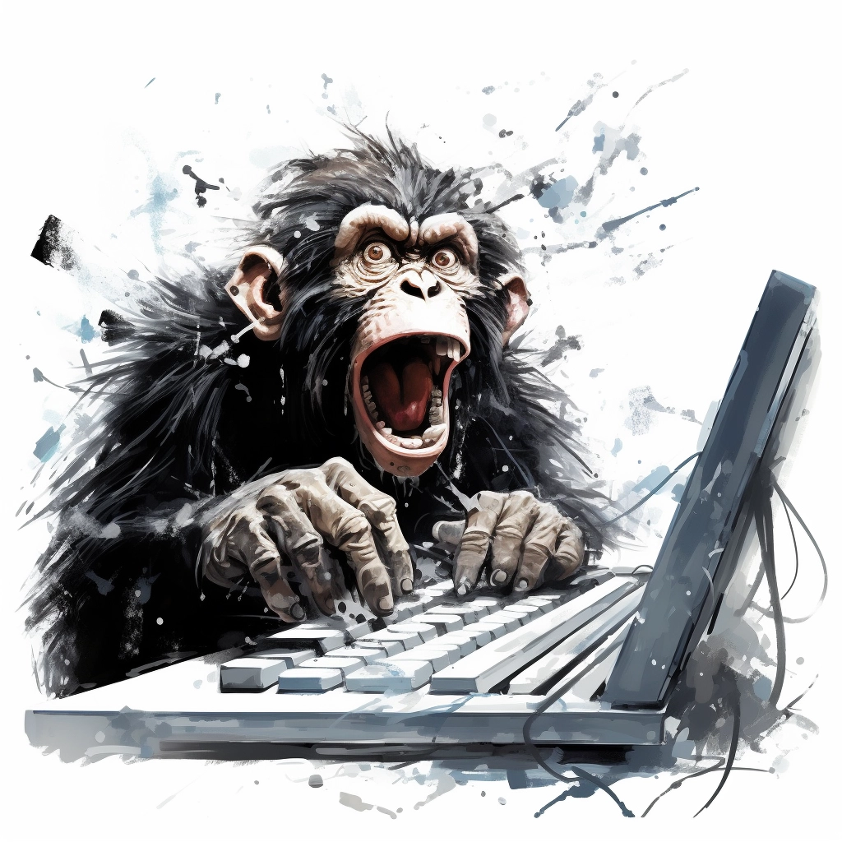
Creating new words

Slide 3
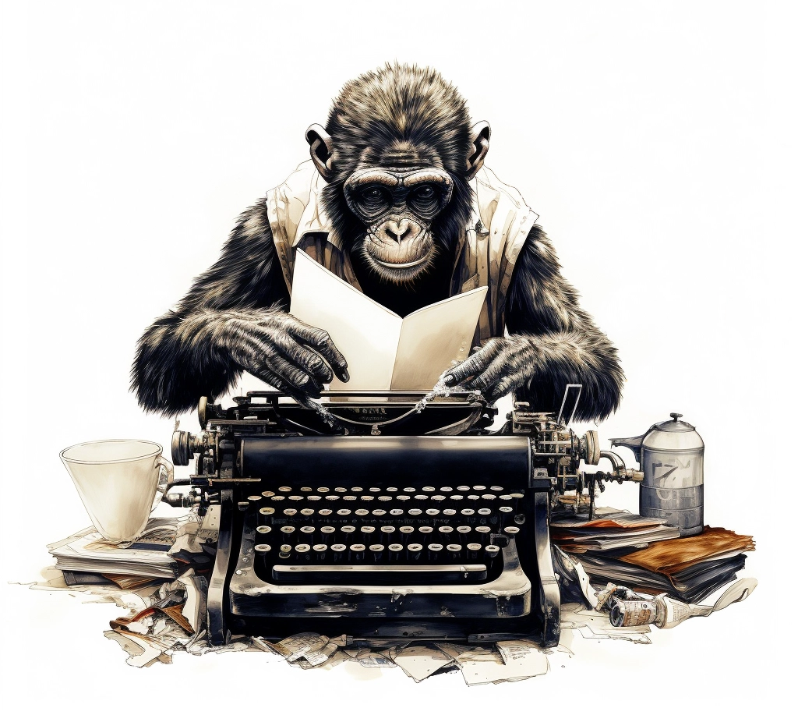
Method 1:
Randomly type on a keyboard

Slide 4
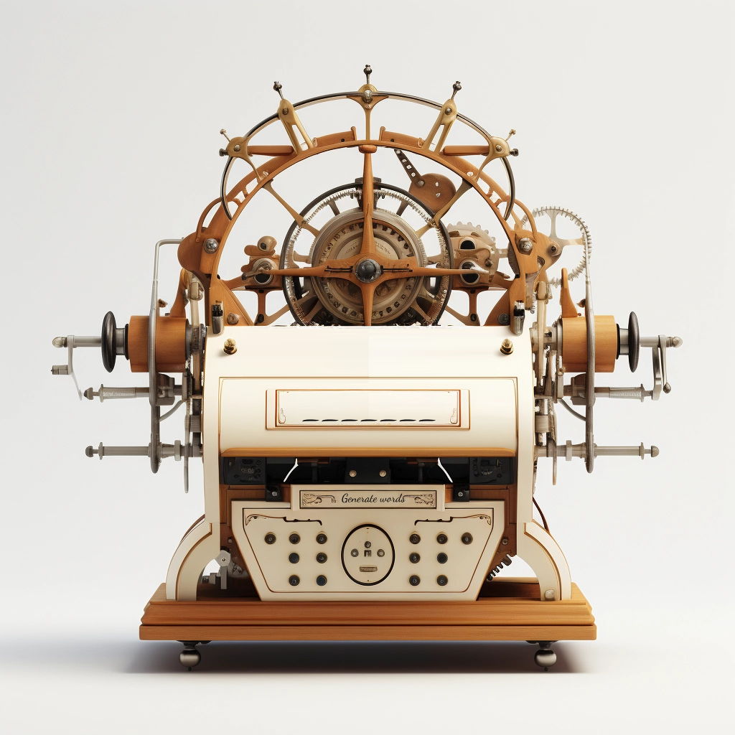
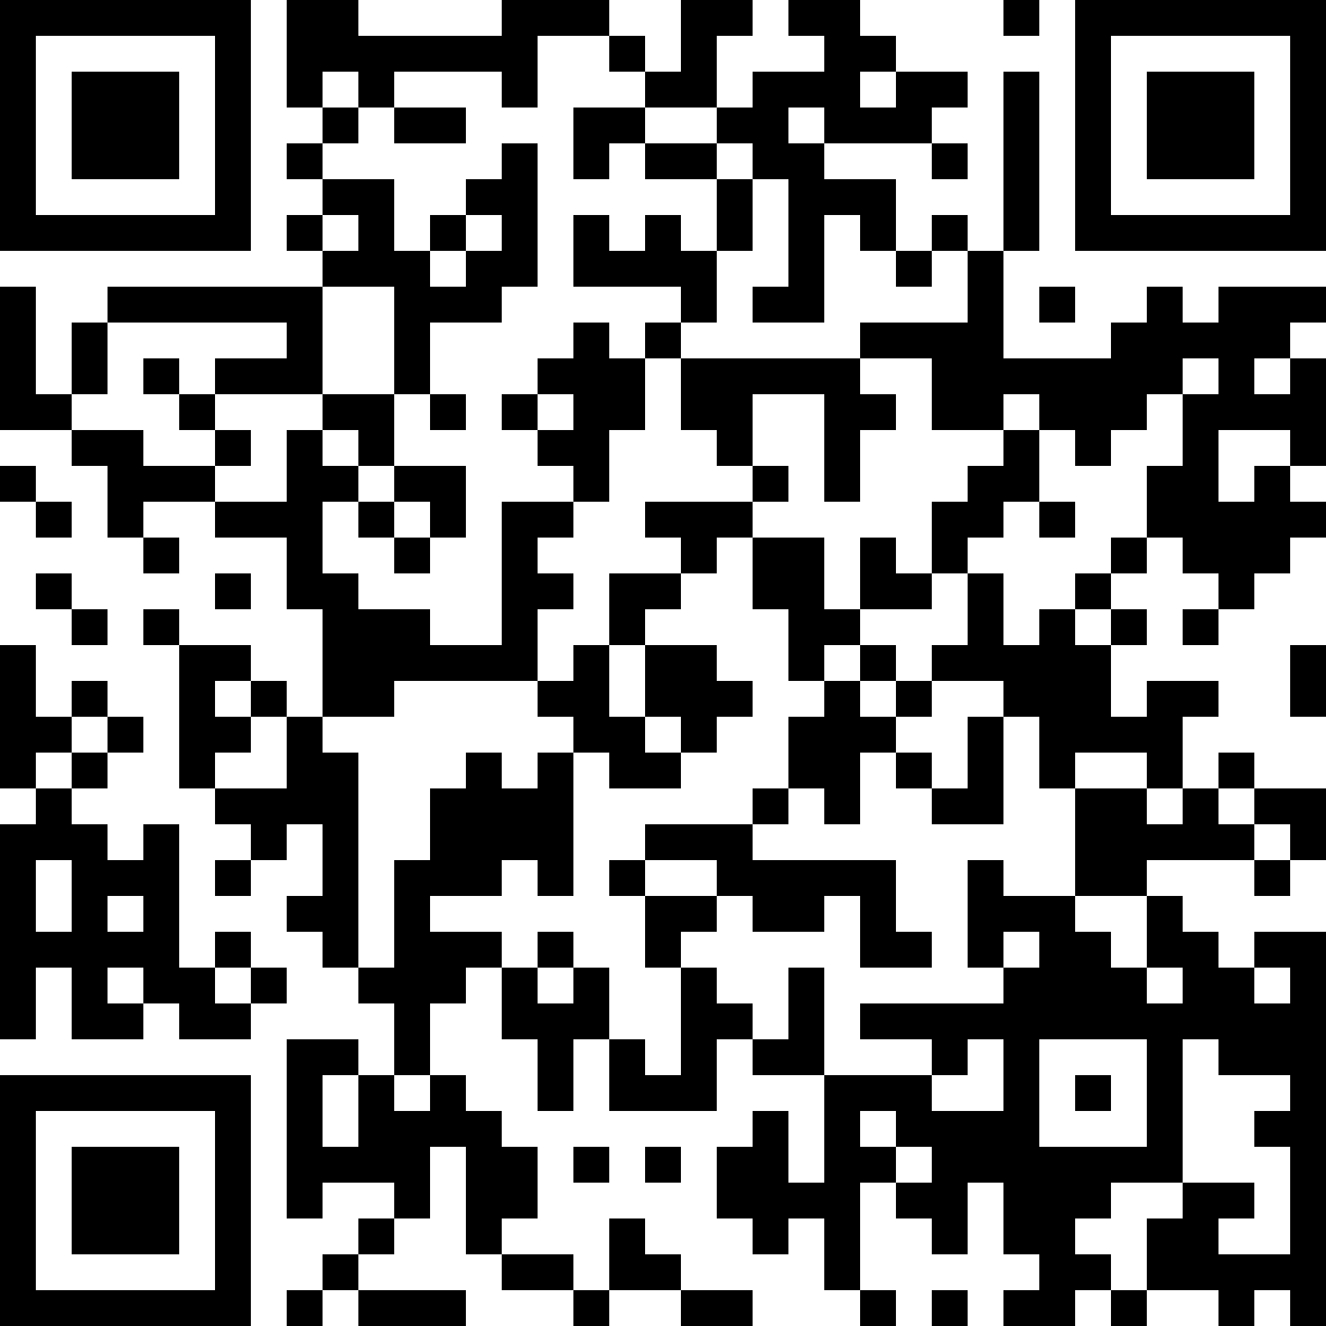
Words Generator Machine 1
https://pauldubois98.github.io/GenerativeAI/word_generator1.html

Slide 5
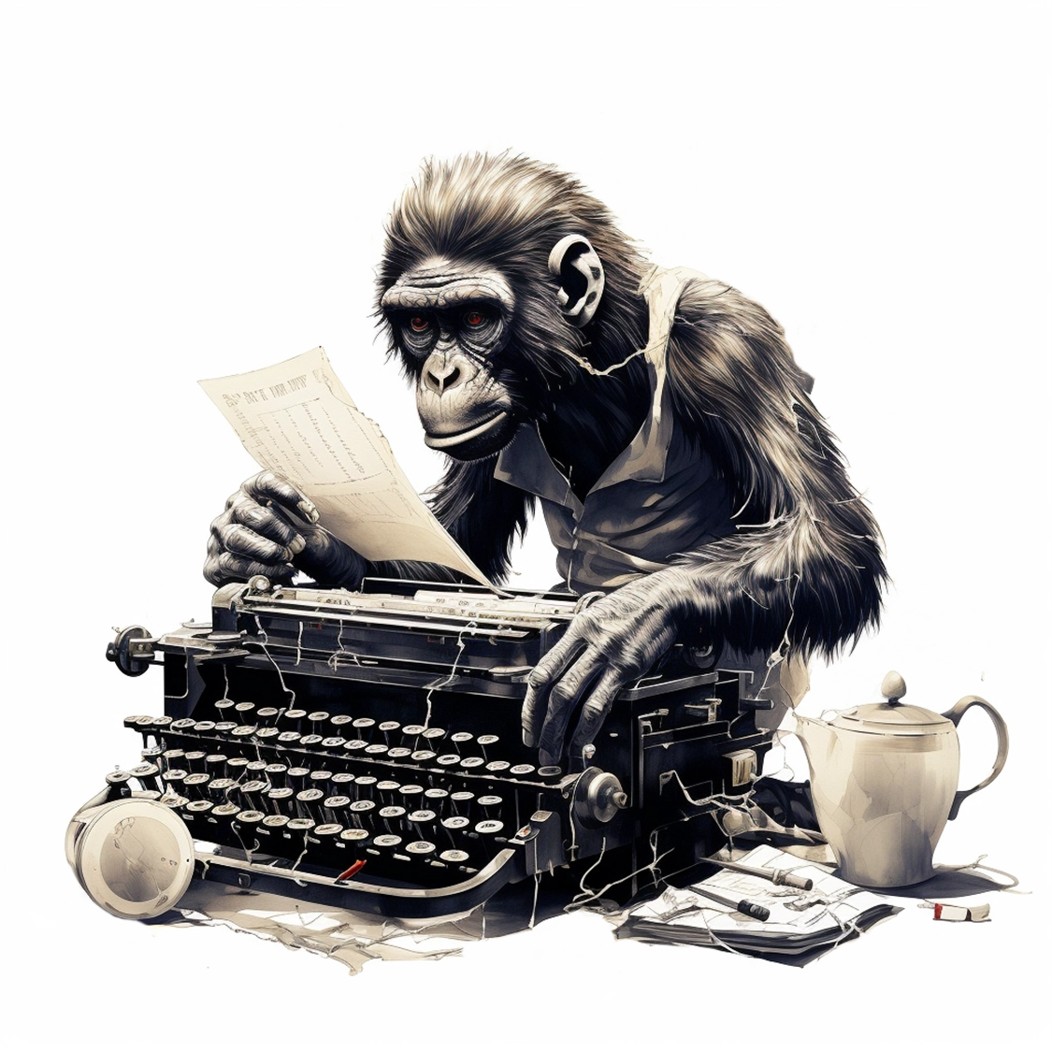
Method 2:
Type on a weighted keyboard

Slide 6
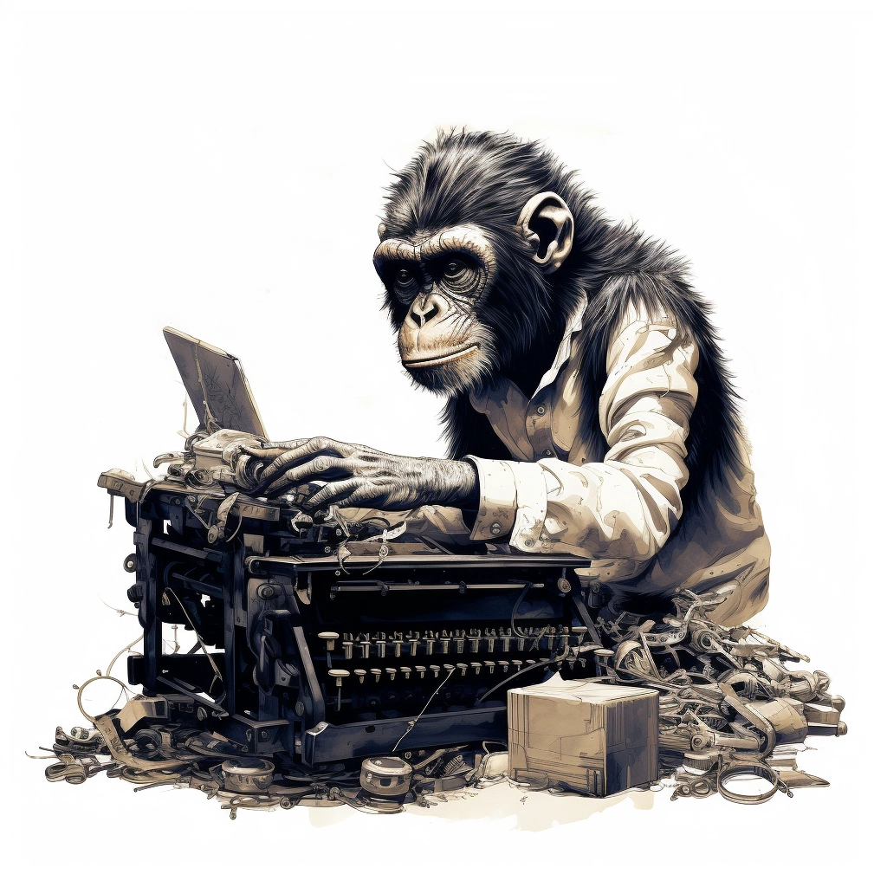
Method 3:
Dynamically weighted keyboard

Slide 7
Predict letters

Slide 8
Generator vs Discriminator

Slide 9
Denoising

